Slide 1
Budget Mobile Insights: A Detailed Amazon Analysis
Prasanth M

Slide 2

OBJECTIVE
The project aims to analyze budget mobile phones on Amazon by examining product prices, customer reviews, and ratings.
Insights derived from statistical analysis and a Power BI dashboard will guide stakeholders in understanding market trends and consumer preferences.

Slide 3
Web Scraping
Tools Used:
Python, BeautifulSoup
Data Collected:
Product Name, Price, Discount, Review Count, Ratings, Description
Output:
A CSV file containing the scraped data.

Slide 4
Data Cleaning and Statistical Analysis
Tools Used:
Python, MS Excel
Process:
Cleaned and preprocessed the data
Conducted exploratory data analysis (EDA) to identify trends and correlations
Used statistical methods for hypothesis testing
Output:
A Jupyter Notebook detailing the EDA and statistical findings

Slide 5

Descriptive statistics
The analysis reveals a mean product price of approximately Rs 20,561.44, with substantial discounts averaging 19.83%, catering to diverse market segments.
Review ratings average 3.87, indicating overall satisfaction.
The correlation analysis reveals discounts moderately correlate with actual price (0.267), while the impact of reviews on ratings and pricing is minimal.

Slide 6

ANOVA TEST
p-value (PR(>F)): 0.007631
Since this p-value is less than the common significance level of 0.05, you reject the null hypothesis. This suggests that there are significant differences in average ratings among the different brands.

Slide 7
Storing Data in MySQL
Tools Used:
MySQL, Python (MySQL Connector)
Process:
Designed a MySQL database schema to accommodate the cleaned data.
Imported the dataset into the MySQL database.
Output:
MySQL database with structured tables and SQL scripts for table creation.

Slide 8
Creating a Power BI Dashboard
Tools Used: Power BI
Process:
Connected Power BI to the MySQL database.
Developed an interactive dashboard visualizing key insights.
Output:
A comprehensive Power BI dashboard.

Slide 9

POWER BI
DASHBOARD

Slide 10
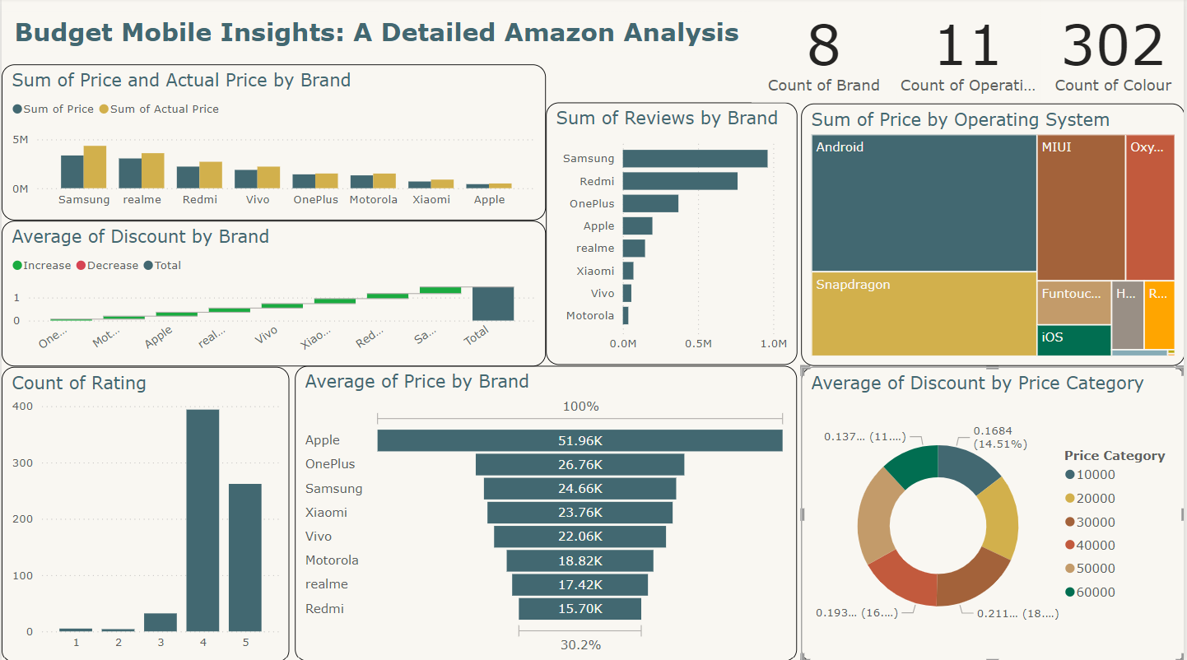

Slide 11
Pricing Strategy
Discount Impact
Customer Satisfaction
Market Segmentation
Review Analysis

Slide 12
THANK YOU ALL…
PRASANTH M

